Slide 1


City of
Thief River Falls
2024
PROPERTY TAX
AND
BUDGET INFORMATION
Truth-in-Taxation Hearing
December 5, 2023
6:00 pm

Slide 2
Agenda
Budget Process to Date
Property Taxation 101
Tax Levy and General Fund Budget
Enterprise Fund Budgets
Conclusion / Summary
Next Steps

Slide 3
Budget Process to Date

Slide 4
Budget Process to Date
City Council and Staff started the Budget June 1st, 2023. Several individual and committee meetings, and Budget and Finance Committee meetings have been held.
The City Council adopted the preliminary budget and tax levy on September 19th , 2023

Slide 5
Budget Process to Date
TONIGHT – Truth-in-Taxation Hearing
Tuesday December 19th, 2023 - The 2024 Final Budget and Tax Levy will be adopted by the City Council

Slide 6
Property Taxation 101

Slide 7
Explanation of the Property Tax Rate
Thief River Falls’ property tax rate is set by taking the city’s tax levy and dividing it by our total tax capacity.
$3,660,960 (8.5% Proposed Levy) / 7,389,328 (Total TC) = 49.544%
The original September proposed levy at 10% the calculation goes as follows:
$3,711,572 (10% Proposed Levy) / 7,389,328 (Total TC) = 50.23%
Total Tax Capacity – determined by multiplying a property’s market value by its classification rate.

Slide 8
CITY OF THIEF RIVER FALLS
LOCAL TAX RATE
 | 2021 | 2022 | 2023 | Proposed 2024
TRF** | 52.854% | 53.166% | 51.402% | 49.544%
Pennington County | 73.763% | 73.442% | 59.914% | 56.325%
ISD #564 | 37.329% | 38.008% | 30.374% | 26.581%
Special Tax Districts* | 4.96% | 4.754% | 3.941% | 4.177%
Total | 168.906% | 169.368% | 145.631% | 136.627%
*Red Lake Watershed District, NW Regional Development Commission, and NW Minnesota Multi-County HRA **TRF proposed rate in September was 50.23% with our estimated TC

Slide 9
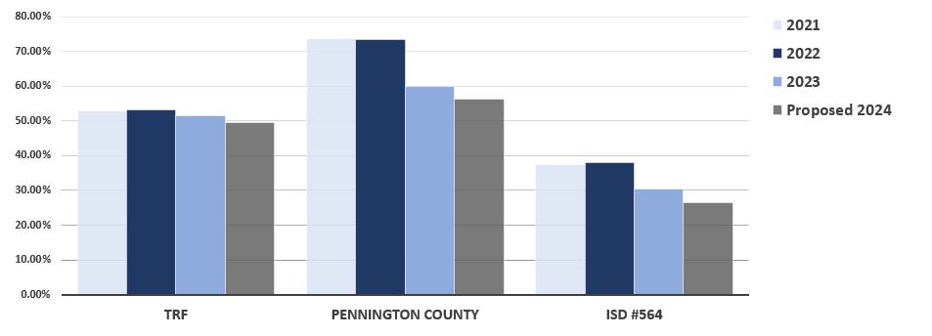
CITY OF THIEF RIVER FALLS
LOCAL TAX RATE COMPARISON

Slide 10
Property Taxation 101
How is the City’s portion of my proposed tax bill determined for a residential property?
[parcel market value] – [homestead exclusion] x [parcel class rate] x [city tax rate] = City portion of your tax bill
Example:
$200,000 (home) - $17,200 (exclusion) x 1.0% (class rate) x
.49544 (city’s new proposed tax rate) = $905.67

Slide 11
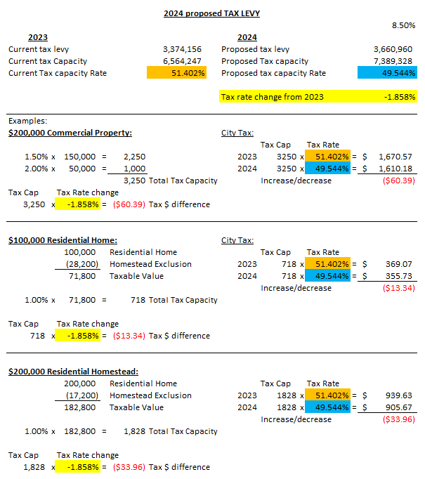

Slide 12
Comparison of 2022 City Taxes
(Based on $100,000 home)

Slide 13
CITY OF THIEF RIVER FALLS
MARKET VALUE

Slide 14
CITY OF THIEF RIVER FALLS
TAX CAPACITY VALUES

Slide 15
Why Property Taxes Vary from Year to Year
Market value changes
Budgets and levies of various jurisdictions
Special assessments
Voters approve a referendum
Changes in Federal and State mandates
Changes in aid and revenue from State and Federal Governments
State Legislative changes

Slide 16
Proposed 2024 Tax Levy and
General Fund Budget

Slide 17
CITY OF THIEF RIVER FALLS
2020-2024 PROPERTY TAX LEVY

Slide 18
CITY OF THIEF RIVER FALLS
PROPERTY TAX LEVY HISTORY

Slide 19
CITY OF THIEF RIVER FALLS
LOCAL GOVERNMENT AID

Slide 21
CITY OF THIEF RIVER FALLS
MUNICIPAL CORPORATION
GOVERNMENTAL FUNDS |  | PROPRIETARY FUNDS
GENERAL FUND |  | ENTERPRISE FUNDS
DEBT SERVICE FUNDS |  | Liquor Dispensary
SPECIAL REVENUE FUNDS |  | Electric
CDAB Revolving Fund |  | Water
Tax Increment Financing Districts |  | Waste Water
Greenwood Cemetery Fund CAPITAL PROJECT FUNDS |  | Storm Water
Splash Park Fund Swimming Pool Fund |  | Arena, MEC, Tourist Park
Multi-Events Center Fund
Train Canopy Fund
TRF Area K-9 Fund

Slide 22
CITY OF THIEF RIVER FALLS
GENERAL FUND REVENUE INCLUDING DEBT

Slide 23
CITY OF THIEF RIVER FALLS
GENERAL FUND EXPENDITURES INCLUDING DEBT

Slide 24
Proposed 2024
Enterprise Fund Budgets

Slide 25
CITY OF THIEF RIVER FALLS
ENTERPRISE FUND REVENUE

Slide 26
CITY OF THIEF RIVER FALLS
ENTERPRISE FUND EXPENSES

Slide 27
Conclusion of the Proposed 2024 Budget presentation and Truth-in-Taxation Hearing

Slide 28
CITY OF THIEF RIVER FALLS
SUMMARY
The 2024 proposed levy was approved at 10.0% in September. After further discussion with Budget and finance Committee meeting in November, it was recommended to change to the proposed levy to 8.5%.
Bonded Debt increased by $152,954
Continued investment in city-wide capital expenditures
11.8% overall increase to health insurance premiums
$375,494 increase to Local Government Aid funding
Increased transfer from the General Fund to the Cemetery Fund to $85,000.
Budgeted Use of Reserves for the General Fund is in the amount of $20,000

Slide 29
Next Steps
The City of Thief River Falls’ Final levy and Budget will be voted on December 19th, 2023 at the City Council meeting
City will certify the final levies to the County by December 29, 2023.
Questions?
THANK YOU!

